Slide 1
Artistic Gymnastics World Championship
Sidney Katz
Lauren Taft Shefali Sinha

Slide 2
Goal Statement
Find a way to analyze data from the Artistic Gymnastics World Championship performance from a team and individual scores.
Find a way to visualize the data of how each team and individual succeded through out each of the events while increasing their level of difficulty by adding spacial skills and combinations to their routine.
Determine how well USA gymnists perform against the other countries

Slide 3
Data Source(s)
Men’s All-Around Final
https://www.usagym.org/PDFs/Results/m_18worlds_aa.pdf
Data Collected: Individual scores of the Championship finalists
Competition Data:
Six different events.
Level Of Difficulty Scores
Execution Scores
Gymnast Individual Data:
Name
Country
ID number
Men’s Team Final
https://www.usagym.org/PDFs/Results/m_18worlds_team.pdf
Data Collected: Scores of Different Countries who competed in the championship. There are six different event in which the team members can compete. For each events, top three scores have been recorded. They compare against the other teams top event scores as well as their overall scores.

Slide 4
Challenges
Problem 1 :
Unable to scrape the pdf on website. So we copied the data in excel, made the required changes, and saved in cvs files to load.

Slide 5
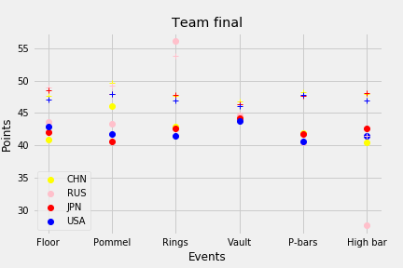
Team Finals by Country
Analysis 1
This plot represents the different Nations that competed with their teams. The “+” symbol indicates the level of difficulty each team could have scored; various skills and combinations a team performs will add to their difficulty level and is then weighed against their actual score.
From our analysis, USA’s difficulty is slightly less than their competitors by 1 to 2 points. If they can increase their dificulty performance over 1 to 2 points this would place the USA at the top of the competition.
In addition the most challenging event in this competition for the USA to win would be on Pommels because China is leading by approx. 5 points, and also has performed at the highest difficulty.

Slide 6
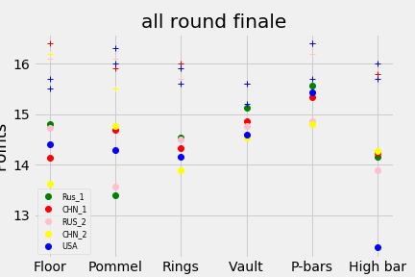
All Around Men’s Final - Individual
Analysis 2
This plot represents the top 5 individual scores that competed in this competition. The “+” symbol indicates the level of difficulty each individual could have scored; various skills and combinations one performs will add to his difficulty level and is then weighed against his actual score.
USA’s gymnast was luckily one of the top 5 competetors of the championship. As you can see in the graph, USA was only five-tenth’s (5/10) from having the highest score for all the events except High Bar.
An unfortunate event occurred while the USA gymnast was competing in the High Bar competition in which he fell and lost a lot of points during his performance. Evenso, he executed the highest level of difficulty in this event.

Slide 7

Analysis Conclusions
The USA holds a very strong performance record in the National stage of gymnastics.
Enjoy the video!

